Slide 1
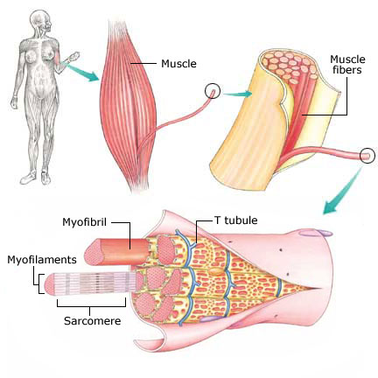
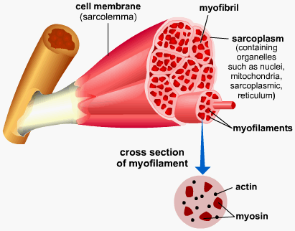
Types of Complex tissues
Muscular tissue :
Muscular tissue consists of elongated cells called muscle fibres.
This tissue is responsible for movement in our body.
Muscle contains special proteins called contractile proteins.
These proteins contract and relax to cause movement of muscles.

Slide 2
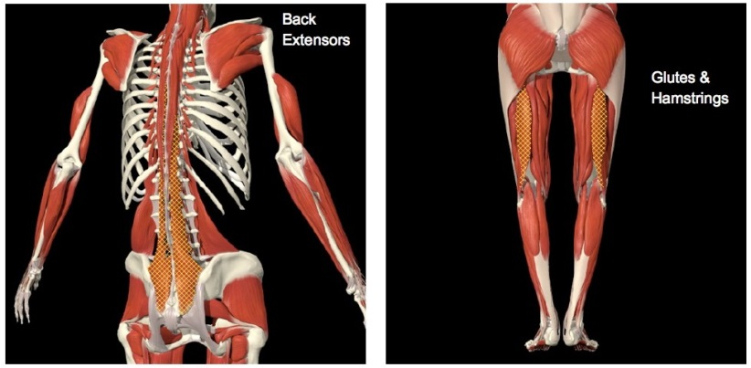
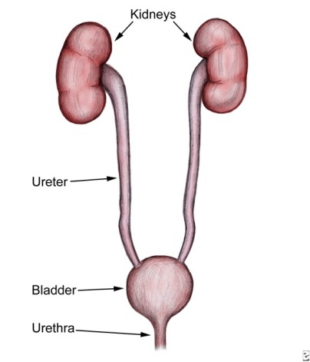
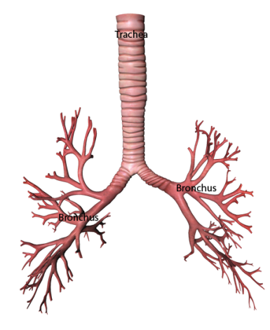
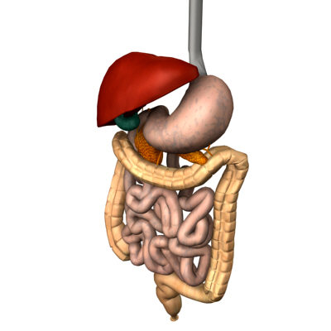
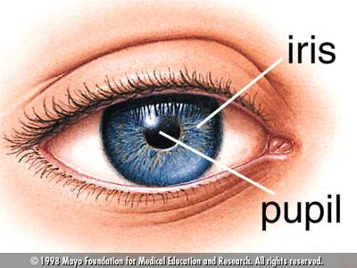
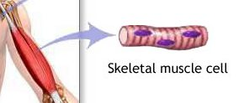
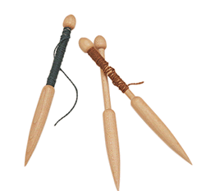
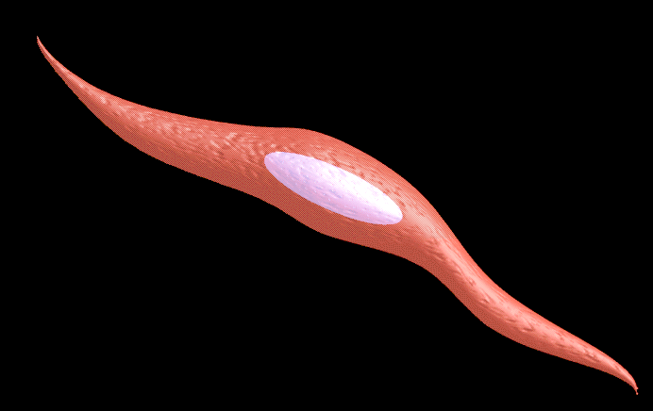
Muscles
are of two types
Voluntary
Involuntary
Control the movements according to our will.
They are mostly attached to bones and help in body movement.
They are also called skeletal muscles.
Under electron microscope, they show alternate light and dark bands.
Hence they are called striated muscles.
The cells of this tissue are long, cylindrical, unbranched and multi-nucleated.
We can not start or stop the movement by our conscious will.
They are found in alimentary canal, iris of the eye, ureters and bronchii of the lungs.
The cells are spindle-shaped and uninucleate.
They do not have striations. Hence they are also called unstriated muscles.
Digestive system
Tubes carrying urine from kidney to bladder
Branches of wind pipe
A thin circular structure in the eye which controls the diameter and size of the pupils and thus the amount of light entering the eye.
Light band
Dark band
Having many nuclei
Shaped like a spindle. Spindle is a device to spin fibers into threads.
Also called as striations.
Having one nucleus

